Slide 1


ENERGYVISTA
A COMPREHENSIVE EXPLORATION OF THE GLOBAL ENERGY MARKET
AYUSH KUMAR (RA2211056010011)
MOHAMED IRSATH (RA2211056010055)
ANISH SARKAR (RA2211056010056)

Slide 2


CONTENT
01
02
03
04
05
06
07
ABOUT OUR PROJECT (INTRODUCTION)
ABSTRACT
PROBLEM STATEMENT
OBJECTIVES
CONCEPT BEHIND PROJECT
RESULT
CONCLUSION

Slide 3




ABOUT OUR PROJECT
In an era defined by the imperative for sustainable energy practices, understanding the complexities of global energy dynamics is crucial. " EnergyVista" stands as a robust Python-based tool, dedicated to a
thorough exploration of extensive energy datasets spanning multiple years.
This project focuses on visualizing energy production and consumption patterns, unraveling temporal trends, conducting resource-specific
analyses, and employing time series forecasting. By leveraging advanced analytical methods, EnergyVista seeks to i l luminate the geographical
distribution of energy production, temporal influences on global energy
trends, and the role of diverse resources in shaping the energy market. The integration of XGBoost for forecasting adds a predictive dimension, offering glimpses into future consumption patterns.

Slide 4

ABSTRACT
"EnergyVista: Global Energy Analysis" employs Python libraries to comprehensively analyze energy production and consumption trends. The project explores datasets, visualizes top energy-producing and consuming countries, and utilizes choropleth maps to highlight geographical distribution. Seasonal decomposition uncovers temporal patterns, while resource-specific analyses delve into coal, natural gas, nuclear, and petroleum production. A key component involves XGBoost for time series forecasting, predicting future energy consumption. Feature importance analysis reveals influential factors. The project concludes with actionable insights, presented in an interactive dashboard. The code is well-documented for clarity and adaptability.
"EnergyVista" is a vital tool, providing insights for policymakers and industry stakeholders, guiding decisions toward a sustainable and resilient energy future.
Keywords: Energy Production, Energy Consumption, Time Series Forecasting, Resource Analysis, Choropleth Maps, Sustainability, XGBoost, Global Energy Dynamics.

Slide 5


PROBLEM
STATEMENT
Global energy faces imbalances,
overproduction, and inefficiency. The
" EnergyVista" project
analyzes trends, mitigates
overproduction, and
forecasts for sustainability, ensuring a resilient energy future.

Slide 6



OBJECTIVES
Objective n° 1
Objective n° 2
Objective n° 3
The primary goal of the " EnergyVista" project is to conduct a thorough analysis of global energy production and consumption trends.
Through advanced data analysis and time series forecasting, the project endeavors to
The driving behind
force
the
provide insights that makers to
empower energy
decision- resource
" EnergyVista" project is a commitment to
optimize
allocation, promote sustainability, and
address key challenges in the global energy
formulate strategies to curtail unnecessary energy production.
The project aims to
landscape. Motivated
identify the
existing between
and
by the imperative for sustainability and use,
to
disparities production
consumption, with a
on
efficient resource
the project aims
specific
mitigating
focus
analyze production and consumption trends.
overproduction minimizing
wastage.
and energy

Slide 7




CONCEPT BEHIND
PROJECT
A comprehensive exploration of the global energy market involves a thorough analysis of various
aspects shaping the industry. This includes
assessing energy sources, demand and supply dynamics, renewable energy trends, policy
landscapes, market players, technological
innovations, environmental impacts, challenges, and opportunities. Such exploration aids in
understanding imbalances, overproduction, and inefficiencies, allowing for informed decision- making and strategic planning. Projects l ike
" EnergyVista" aim to contribute by providing
predictive insights, mitigating overproduction, and guiding sustainable practices for a balanced and
resilient energy future.
PEOPLE

Slide 8



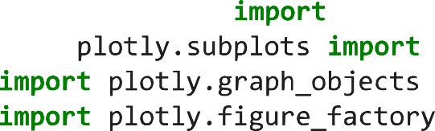




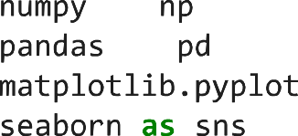



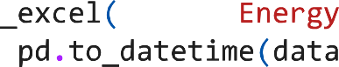

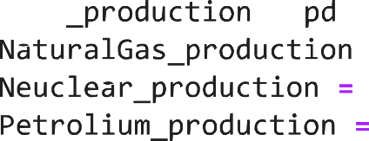
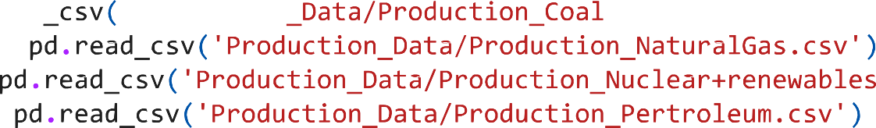

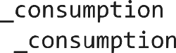

IMPLEMENTATION

Slide 9
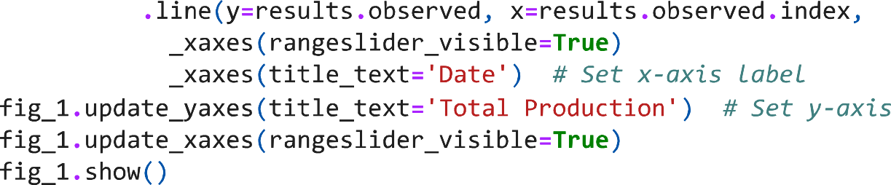

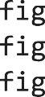
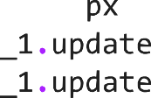
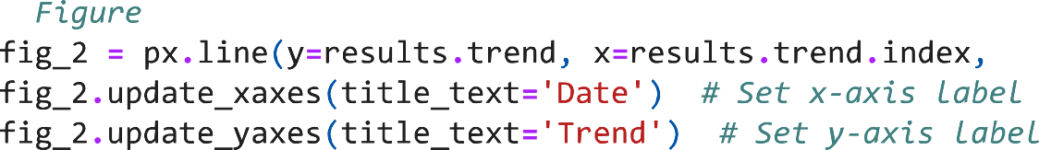


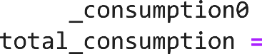
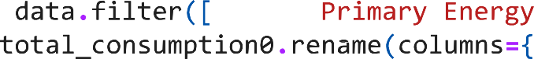






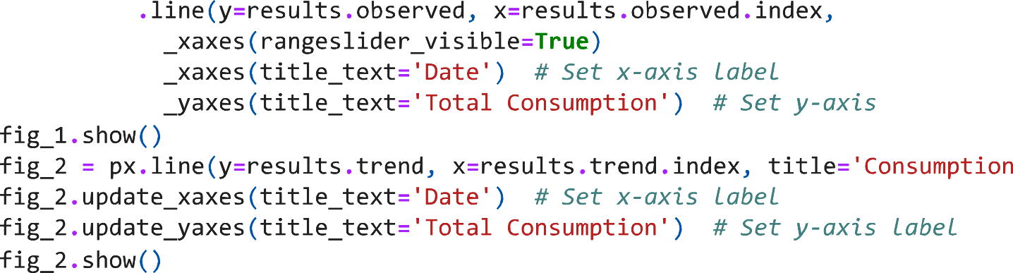

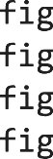
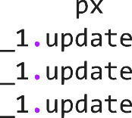



Slide 10






















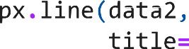
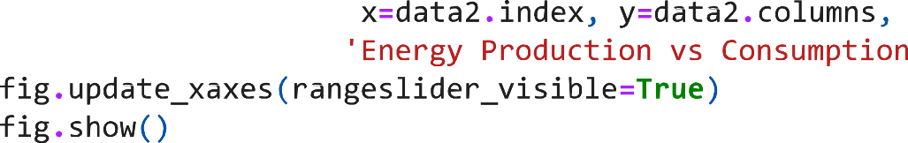














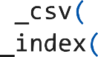
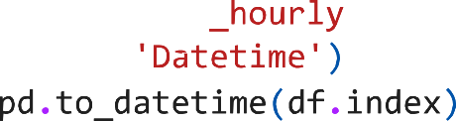



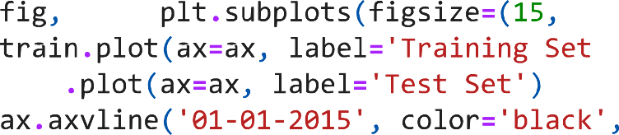
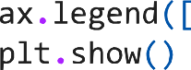


Slide 11
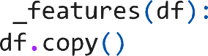





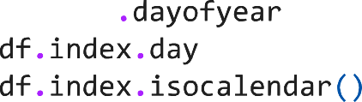

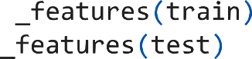


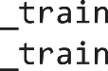






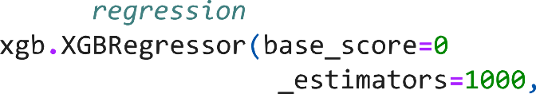

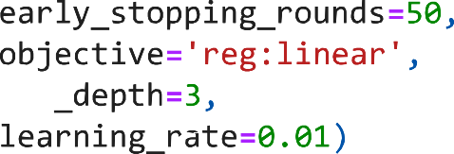
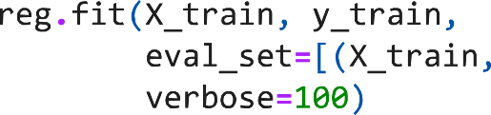

Slide 12
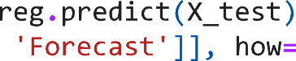



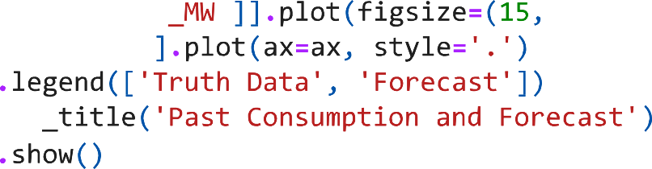

Slide 13











RESULT
PRODUCTION ANALYSIS

Slide 14
















Slide 15


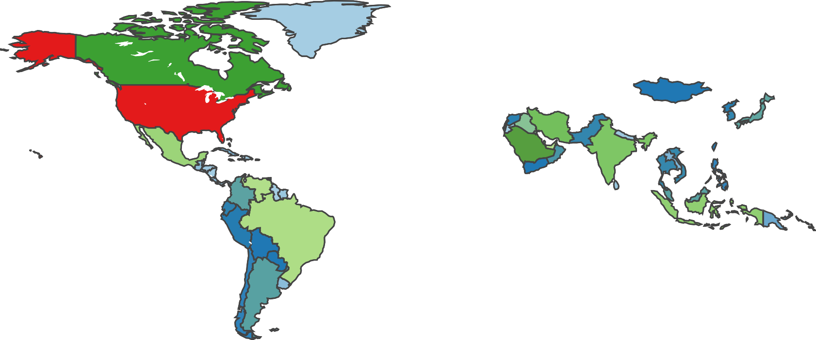




Slide 16













CONSUMPTION ANALYSIS

Slide 17












Slide 18


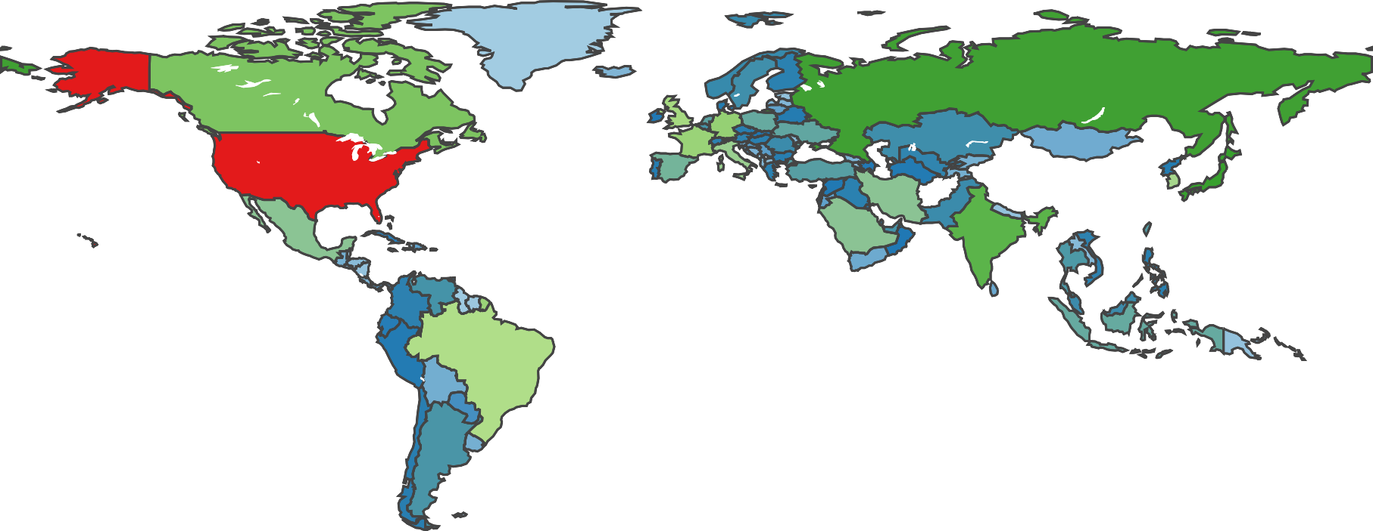

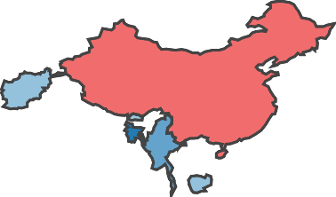
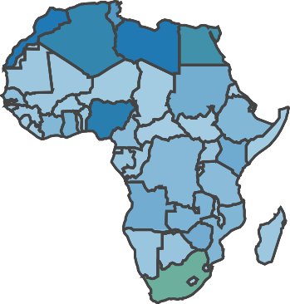



Slide 19



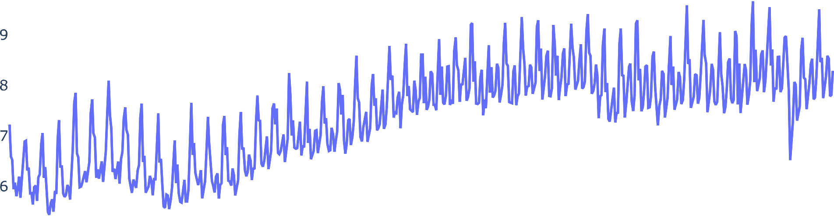




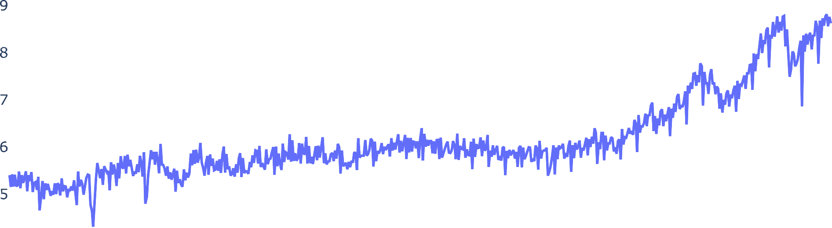


Slide 20
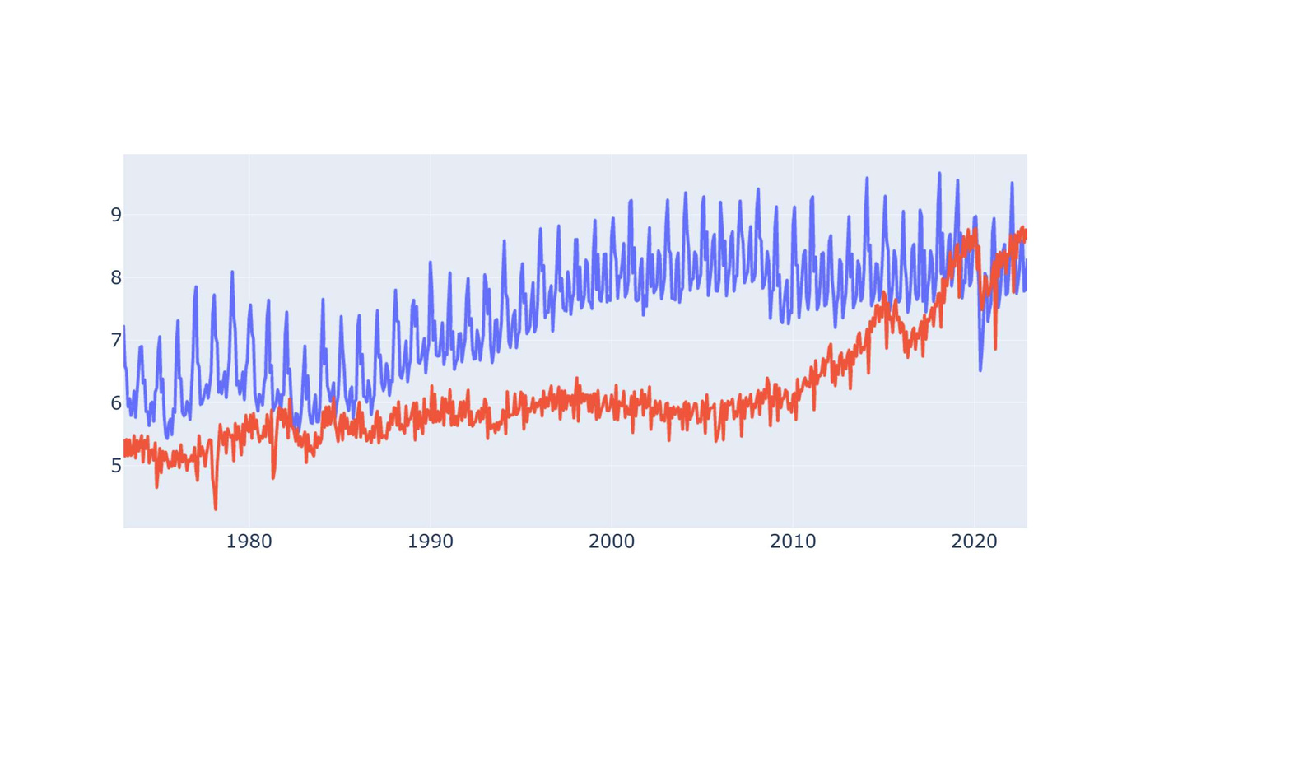




Slide 21
PRODUCTION VS CONSUMPTION ANALYSIS

Slide 22
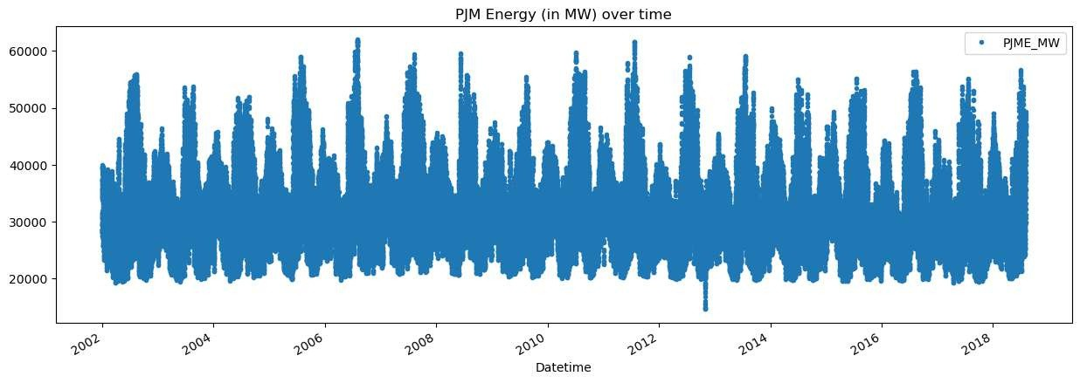
ENERGY FORECASTING USING GRADIENT BOOST
HOURLY CONSUMPTION FROM 2002 TO 2018

Slide 23
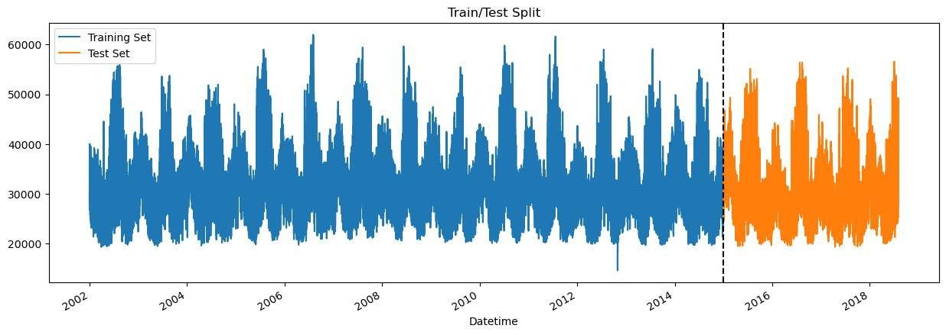
AFTER SEPERATING TEST CASE AND TRAIN CASE

Slide 24
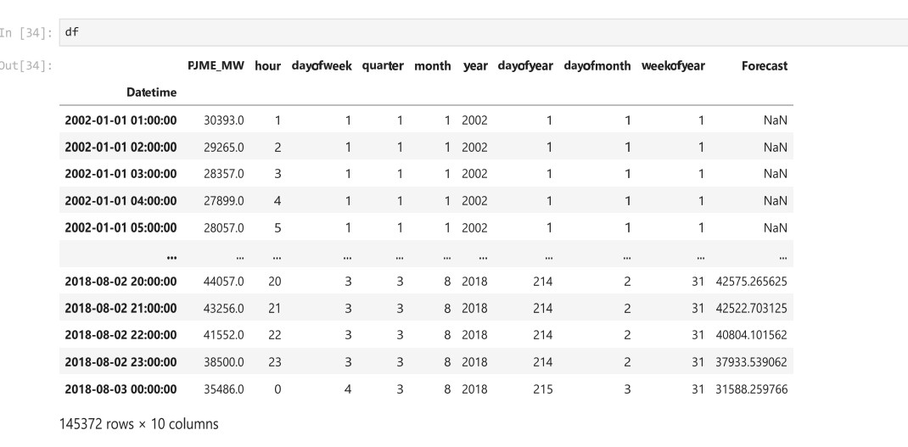
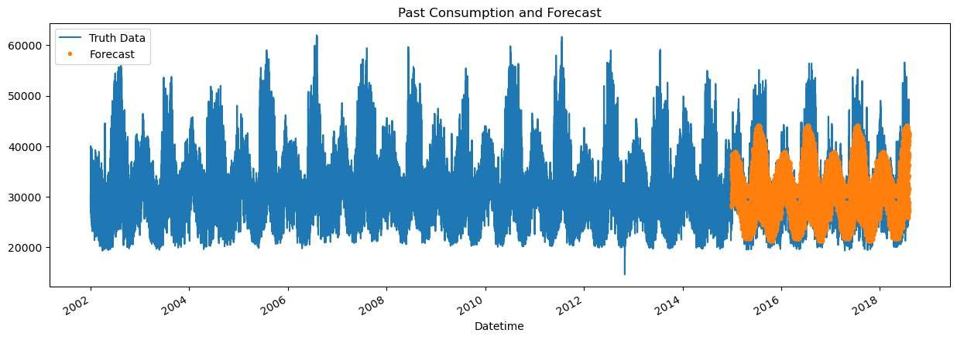
FORECASTED DATA

Slide 25
FORECASTED DATA

Slide 26


CONCLUSION
A comprehensive exploration of the global energy market, integrating data analysis, technological innovation, and sustainable practices, is essential for informed decision- making, addressing imbalances, and building a resilient energy future.

Slide 27

REFERENCE
https://www.sciencedirect.com/science/article/pii/S037877 8823002761
https://ieeexplore.ieee.org/document/7518355 3.https://energsustainsoc.biomedcentral.com/articles/10.1186
/s13705-019-0197-0
“Load Profiles and Their Use in Electricity Settlement”- Elexon guide 7th November, 2013.
S.K. Sinha, S.K. Soonee, S.S. Barpanda, K.K. Ram Eastern Region Power Demand Scenario- A forecast GMPS-2000.

